Slide 1


Optimization of Machine Downtime by Kamalika Bhattacharya

Slide 2
Contents
Business Objective
Business Constraints
Project Architecture
Data Collection
Exploratory Data Analysis
Data Visualization
Notes:
Change

Slide 3
Business Problem
Unplanned machine downtime in machines which manufacture the pumps.
The production line has been severely impacted by unexpected equipment failure in the manufacturing machinery of the pumps.
This malfunction has resulted in a significant decline in productivity, causing delays and production gaps.

Slide 4
Project Overview and Scope
Business Objective : Reducing unscheduled machine downtime by identifying potentially defective equipment and functions is the business's main goal.
Business Constraint: Minimizing the maintenance cost
Scope of the project :
Business Success Criteria: The minimum 10% reduction in unscheduled machine downtime is a requirement for corporate success.
Economic Success Criteria: saving at least one million dollars in costs.

Slide 5
Data Dictionary
In our dataset the concerned functionalities to find out the reason for unplanned machine downtime are:
Date
Machine ID
Assembly Line No
Hydraulic Pressure(bar)
Coolant Pressure(bar)
Air System Pressure(bar)
Coolant Temperature
Hydraulic Oil Temperature(Â°C)
Spindle Bearing Temperature(Â°C)
Spindle Vibration(Âµm)
Tool Vibration(Âµm)
Spindle Speed(RPM)
Voltage(volts)
Torque(Nm)
Cutting(kN)
Downtime

Slide 6
Exploratory Data Analysis [EDA]
Statistical Insights
Business Insights
Number of counts of Machine Failure: 1265
Number of counts of No Machine Failure: 1235
Hydraulic Pressure has a standard deviation of y 30.29, indicating relatively moderate variability around its mean and Cutting has a standard deviation of about 6.14, signifying higher variability in its values.
Moderate negative correlation (around -0.22) between Cutting and Hydraulic Pressure.
Coolant Pressure has a positive correlation with Cutting and Higher coolant pressure might be associated with increased
Decreased torque might relate to increased Cutting
.
Higher spindle speeds might relate to increased downtime.
High hydraulic pressure, low coolant pressure, and certain temperature or vibration thresholds might be associated with machine failure.
Analyzing statistical measures such as mean, median, and distribution of downtime helps in understanding the typical duration of downtimes.
Outliers in spindle speed, torque, cutting force indicate instances of exceptional performance or inefficiency. It provide insights into process optimization, such as identifying ideal operating conditions for maximum efficiency or detecting anomalies that might affect product quality.
Machines or assembly lines experiencing frequent failures might require additional attention, resources, or upgrades to improve their reliability.
Notes:
EDA is used for seeing what the data can tell us before the modeling task.
Change

Slide 7
Data Preprocessing
Quartiles (Q1 and Q3) are calculated for each selected numeric column using quantile(0.25) and quantile(0.75) respectively.
The Interquartile Range (IQR) is computed as the difference between Q3 and Q1.
Quartiles (Q1 and Q3) are calculated for each selected numeric column using quantile(0.25) and quantile(0.75) respectively.
The Interquartile Range (IQR) is computed as the difference between Q3 and Q1.
Outliers are detected using the IQR method. Values outside the range of (Q1 - 1.5 * IQR) and (Q3 + 1.5 * IQR) for each numeric column are considered outliers.
An any(axis=1) operation identifies rows where any of the numeric columns contain outliers.
Checking for missing values in the entire dataframe and printing the count of missing values for each column.
Replacing the missing values in numeric columns with mean.
Using select_dtypes, only columns with numeric data types are selected. This step filters out non-numeric columns, focusing specifically on numerical attributes for analysis.
Correlation matrix has been computed and visualized using a heatmap.
Quartiles (Q1 and Q3) are calculated for each selected numeric column using quantile(0.25) and quantile(0.75) respectively.
The Interquartile Range (IQR) is computed as the difference between Q3 and Q1
Values outside the range of (Q1-1.5*IQR) and (Q3+1.5*IQR) for each numeric column are outliers.
An any(axis=1) operation identifies rows where any of the numeric columns contain outliers.
Rows with outliers are displayed.
Replacing values outside the bounds (outliers) with the median value.
Then again correlation matrix has been computed.
Notes:
Keep observations

Slide 8
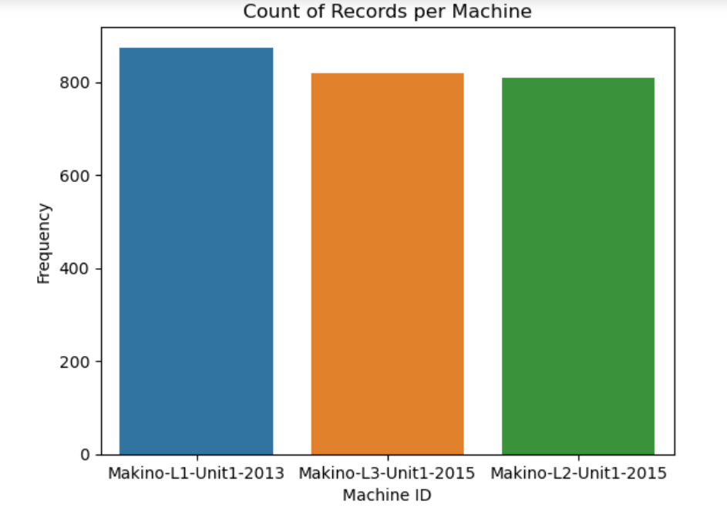
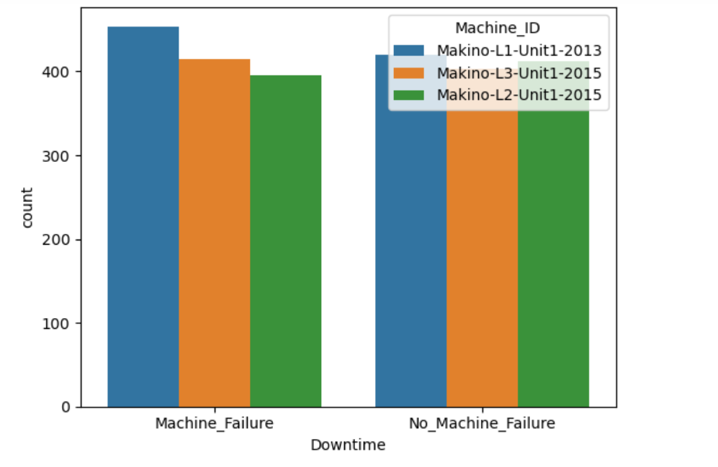
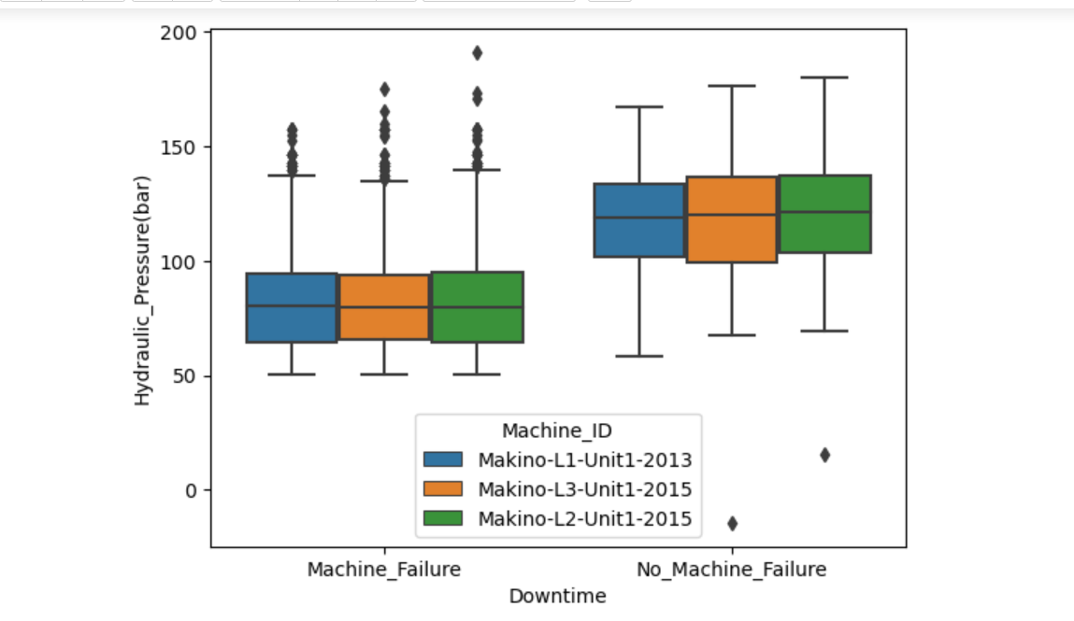
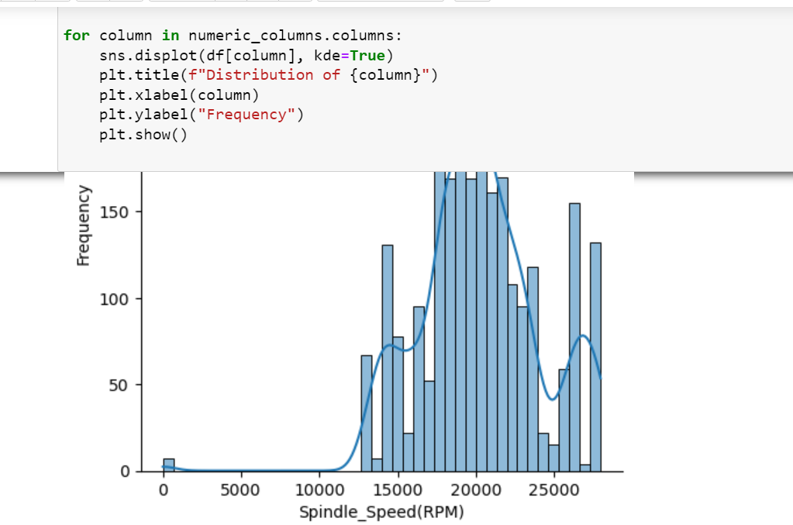
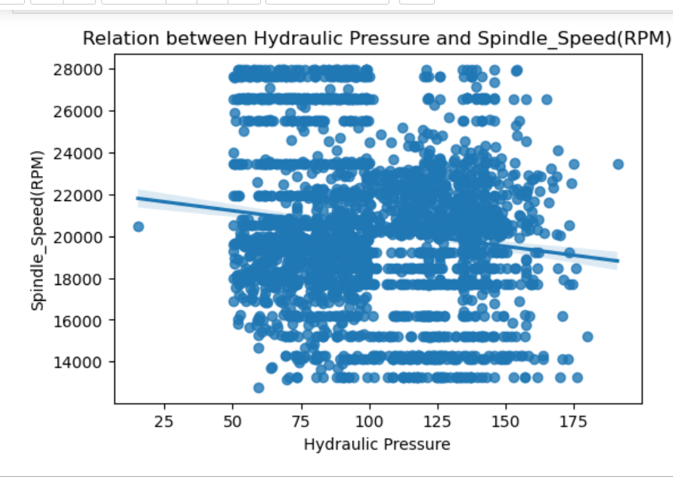
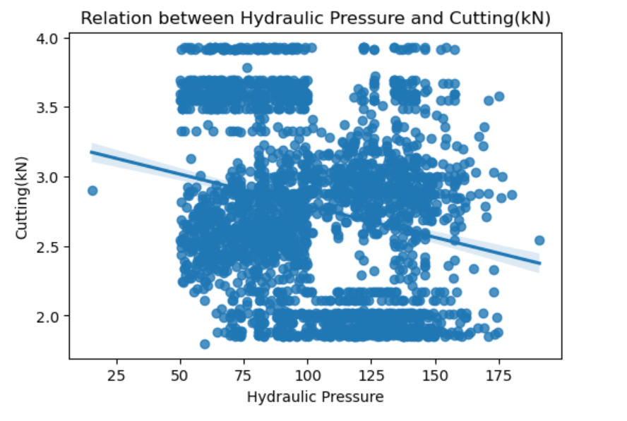
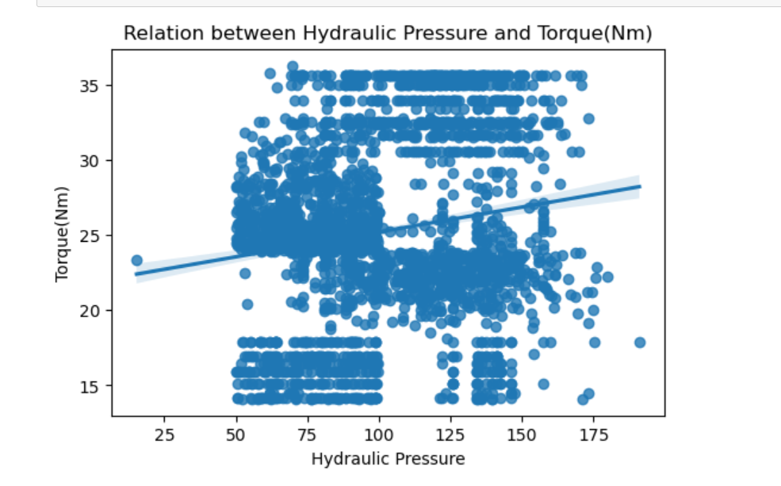
Data Visualization
Notes:
Add graphical

Slide 9


